Slide 1
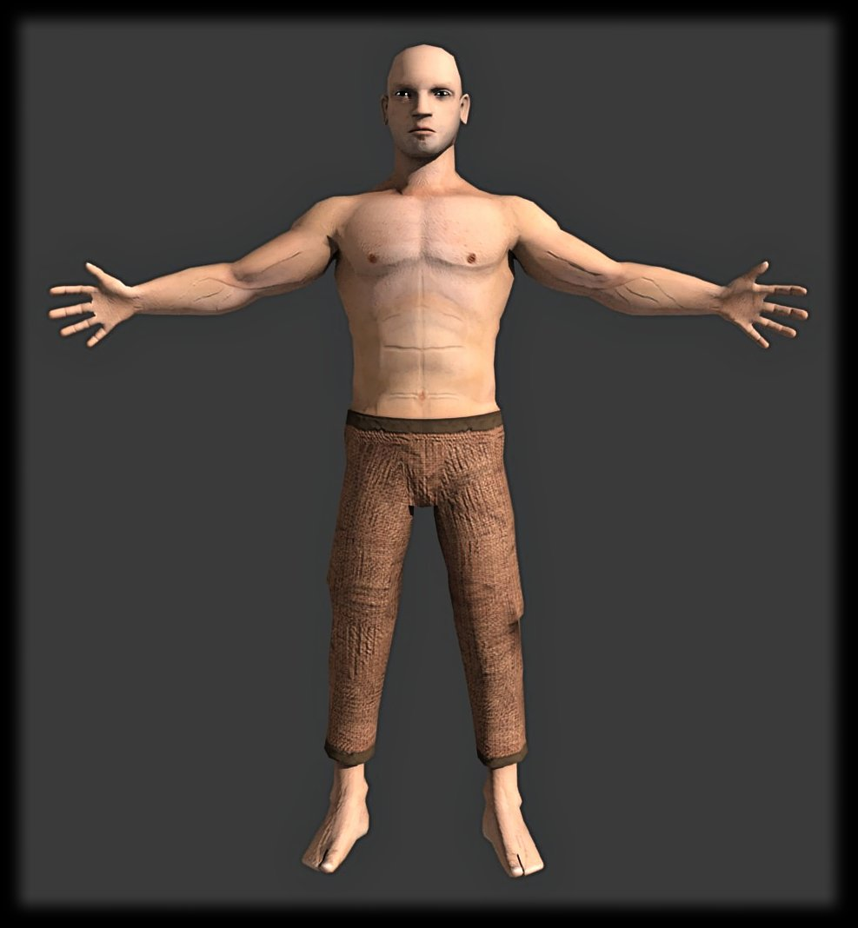
Chapter 2
Cells

Slide 2
Organelle
Name for any cell part

Slide 3
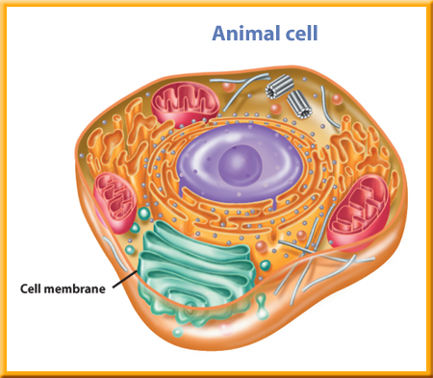
Nucleus
Ribosomes
Mitochondria
1. cell membrane – outer part of cell that lets things in and out.
2. cytoplasm – gel-like material that cell parts float in.
3. nucleus – directs all the cells activities.
4. mitochondria – breaks down food & releases energy.
5. ribosomes – makes protein

Slide 4
Brain Pop
Lysosomes
Golgi Bodies
ER
6. endoplasmic reticulum (ER) – tunnels that move things around inside the cell.
7. golgi bodies – sacs that move protein outside the cell.
8. vacuoles – storage place.
9. lysosomes – digest waste for cell.

Slide 5
Chloroplast
Cell Wall
Plant cells have a cell wall & chloroplast and animal cells do not!!!

Slide 6
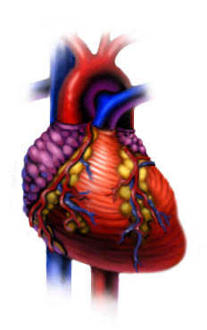
Tissue
group of cells that work together.
1. Video: Cells work together
Organ
groups of tissues that work together.
Organ System
Organism

Slide 7
The Microscope
Video History of Microscope
*Must have a microscope to see cells and viruses.
*Antonie van Leeuwenhoek made the 1st microscope

Slide 8
Video: microscope
How to make a wet mount
* Compound Light Microscope = microscope we use in Life Science.
* Magnification = Multiply the eyepiece times the nosepiece.

Slide 9
Eyepiece 10X
Nosepiece 40X
10
X 40
400 TOTAL MAGNIFICATION
Electron Microscope

Slide 10
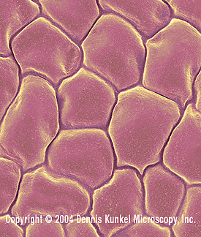
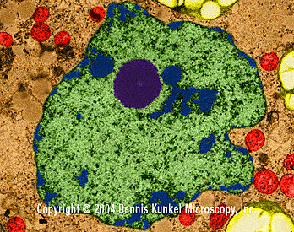
* Robert Hooke= 1st person to see cells.
* Schleiden and Schwann = discovered all living things have cells
Hooke :25
S and S 3:00

Slide 11
Cell Theory
1. All organisms have 1 or more cells.
2. Cells are the basic units of structure in all organisms.
3. All cells come from other cells.

Slide 12
Viruses
Virus infecting cell
Virus pictures
Virus – a strand of hereditary material surrounded by a protein coat.

Slide 13
Host Cell
A living cell where a virus reproduces.
2000X

Slide 14
2 Ways a Virus Acts
1. Active Virus –Enters cell and reproduces until the cell is destroyed.
2. Latent Virus – Enters cell but doesn’t start making new viruses. However, at any time he can become active.

Slide 15
Vaccine
Vaccines
Edward Jenner created the 1st vaccine in 1796.

Slide 16
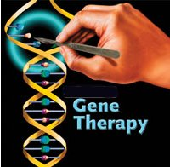
Helpful Viruses
Gene Therapy – Substituting good DNA for incorrect DNA.

Slide 17
What Do Cells Do?

Slide 18
Osmosis
When water moves into and out of the cell by going through the cell membrane.

Slide 19
Diffusion
Video @:22
When molecules move from areas where there are more of them to areas where there are fewer of them.

